Slide 1

CLASS ADVISORY SENATE
Quarterly Update
16 January 2024
Thomas Lenneberg
Executive Director of Development
Air Force Academy Association and Foundation

Slide 2

Our goal is to increase graduate giving

Slide 3
Class Annual Giving
A revamped approach to our annual giving efforts that leverages class identity to galvanize grads around supporting USAFA through the Foundation.

Slide 4
Reunion Giving
Class Giving
Annual Giving
=
+

Slide 5


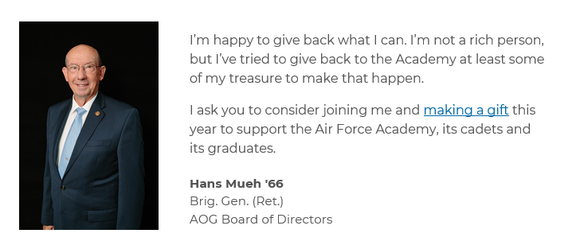
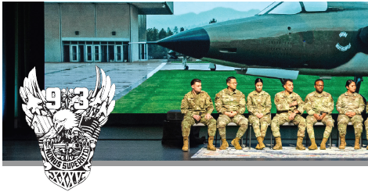
Approach
Wrapping annual giving communications and marketing around class crest, color and motto, and increasing segmentation by class
Putting an increased emphasis on both peer-to-peer outreach and transparency around who is giving
Building out a class advocate structure for increased opportunities to get involved
Leveraging Academy events and milestones
Creating a year-long giving competition among classes

Slide 6
Tell the Class Story – and our Story
Educate
Cultivate
Solicit
Steward
Quarterly email & direct mail spotlighting need for private support
Annual Impact Month
Why I Give graduate & class spotlight stories
Legends outreach
Annual impact reporting
Sabre Society
Peer-to-peer recognition
1954 Society
Class
Identity
Bi-monthly class participation and dollars-raised reporting
Peer-to-peer with class advocates
1Day1USAFA class giving challenge
Year-end challenge
Transition from reunion giving to class giving
Legends calling & digital solicitation
Identify class advocates & build structure for peer-to-peer outreach
Leverage events & milestones
User-generated content from graduates

Slide 7
Getting Involved
Write copy for the Foundation to use in outreach to your fellow classmates and other graduates and allow the Foundation to use your name and likeness in these efforts (or allow the Foundation to write the copy on your behalf and you can just review/edit as you see fit)
Record a short video with a brief note about why you give back and how the Academy, current cadets and fellow graduates benefit from private support and encouraging other grads to consider giving back
Make phone calls, text or send emails to your classmates or other fellow graduates you are close with and encourage them to give back
Allow the Foundation to use your annual donation as a matching or challenge gift to encourage giving from your fellow classmates and other graduates
Be featured/interviewed for a Why I Give story

Slide 8
Thank You

